Slide 1
Kaggle Workshop
Data science using real world datasets
Sign up now at http://kaggle.com

Slide 2
Typical Workflow
Obtaining Data: Download open datasets, collect data
Data Analysis and Visualization: Understand your data
Cleaning Data: Remove outliers, normalizing, fill in missing values, create dummy variables
Creating a Model: Supervised/Unsupervised, tuning parameters
Testing the Model: Analyze results

Slide 3
Today’s Workflow
Obtaining Data: Download from Kaggle
Data Analysis and Visualization: Understand your data using meta data on Kaggle
Cleaning Data: Remove outliers, normalizing, fill in missing values, create dummy variables
Creating a Model: Supervised/Unsupervised, tuning parameters
Testing the Model: Upload results to Kaggle to score

Slide 4
Download Project GitHub Repo
Clone or download as zip to get the starter code
https://github.com/adelehedrick/kaggle-workshop

Slide 5
Requirements
Python version 2.7 (3+ will work but some syntax will be different)
Use pip to install libraries: - Numpy - Pandas - sklearn
Windows users use CMD: python -m pip install <library name>
Linux users use terminal: sudo pip install <library name>

Slide 6
Get the Data
https://www.kaggle.com/c/titanic/data
Create a data folder in the project
Download the train.csv and test.csv and save them to the data folder
Open up the tutorial.py in your favourite Python editor!
The tutorial.py has numbered sections that correspond to the numbers in the following slide headers

Slide 7
Loading the Data Using Pandas
Pandas is a library of data structures and data analysis tools, commonly used for data science and machine learning.
We are going to use pandas to load the contents of the train.csv into a data structure called a DataFrame. A DataFrame is a 2-dimensional array like structure. Think of it as a table of data.
df = pd.read_csv('data/train.csv')

Slide 8
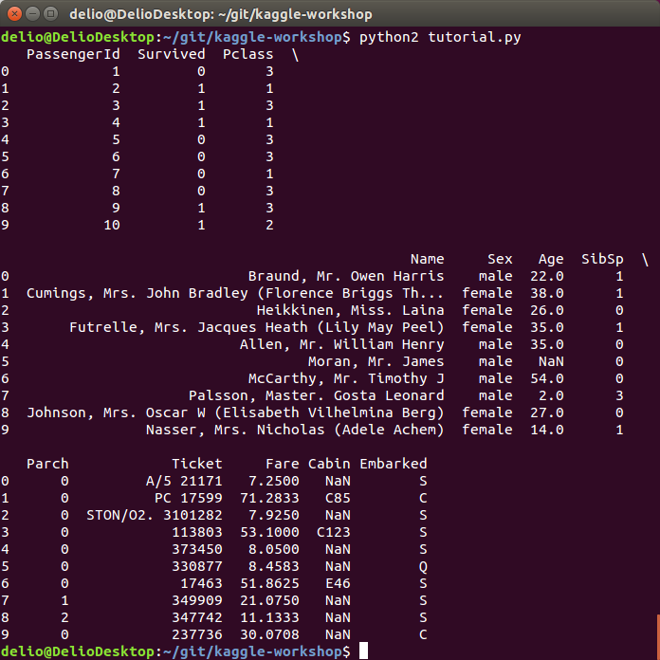
2. Preview the Training Data
print(df.head(10))
You can then run the script with: python tutorial.py

Slide 9
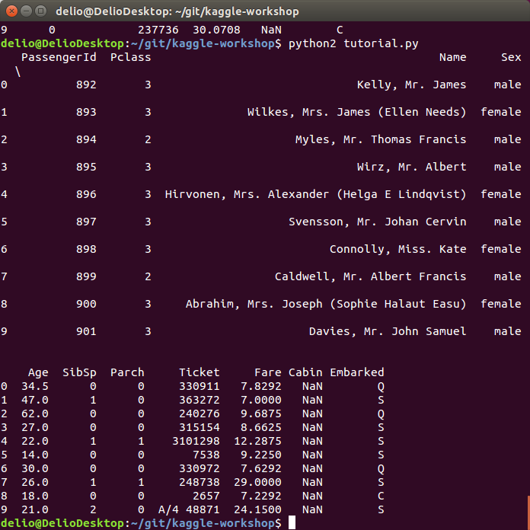
View the Test Data
Change the train.csv to test.csv and run the script again to look at the test data.
df = pd.read_csv('data/test.csv')

Slide 11
The Goal
When comparing the output, we see that the training data contains a survived column and the test data does not.
The goal of this Kaggle challenge is to be able to predict if someone in the test file would survive, 1, or not, 0, aboard the Titanic.
When we make predictions on the test data, we send the results to Kaggle, and they will give us a rank!

Slide 12
Make a Submission
Step 1: Remove irrelevant data Step 2: Remove unknowns (e.g. “NaN”) Step 3: Convert all data to numerical data Step 4: Arrange DataFrame for training Step 5: Train a model Step 6: Make predictions Step 7: Format predictions for Kaggle submission

Slide 13
Load Train Data
Change the test.csv back to train.csv
df = pd.read_csv('data/train.csv')

Slide 14
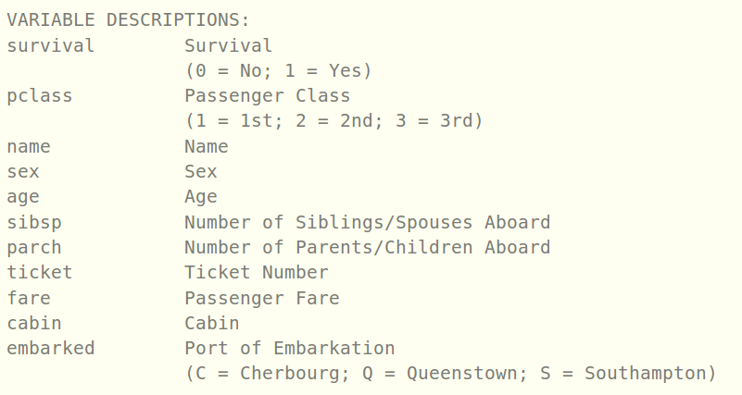
What do the columns mean?
https://www.kaggle.com/c/titanic/data

Slide 15
Remove Irrelevant Data
https://www.kaggle.com/c/titanic/data

Slide 16
3. Remove Irrelevant Data
We are going to make a new DataFrame from the old one, but drop the Name, Ticket, and Cabin columns. (axis=1 means we want to drop columns instead of rows)
df = df.drop(['Name', 'Ticket', 'Cabin'], axis=1)

Slide 17
4. Remove Missing Values
For now we are just going to remove the rows that have missing values, but eventually we will want to address them in a more sophisticated way.
df = df.dropna()

Slide 18
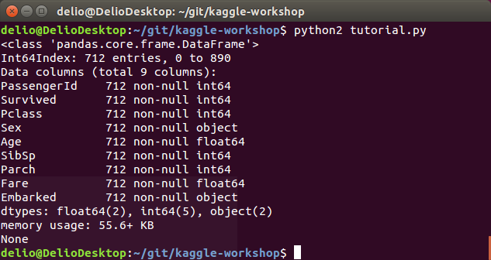
5. Convert All Data to Numerical Data
You can print the information about a DataFrame with:
print(df.info())
Run the script.
Sex and Embarked need to be addressed since our algorithms only know how to handle numerical data.

Slide 19
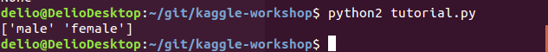
5. Convert All Data to Numerical Data
Print the unique values in the Sex column
print(df['Sex'].unique())
Only two unique types! We can convert this to 1’s and 0’s to represent ‘male’ and ‘female’

Slide 20
5. Convert All Data to Numerical Data
Create a new column, ‘Gender’, to contain the binary representation of the ‘Sex’ column.
df['Gender'] = df['Sex'].map({'female': 0, 'male':1}).astype(int)

Slide 21
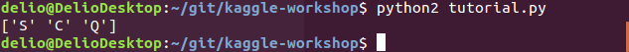
5. Convert All Data to Numerical Data
Print the unique values in the Sex column
print(df['Embarked'].unique())
Only three unique types!

Slide 22
5. Convert All Data to Numerical Data
Create a new column, ‘Port’, to contain the binary representation of the ‘Embarked’ column.
df['Port'] = df['Embarked'].map({'C':1, 'S':2, 'Q':3}).astype(int)

Slide 23
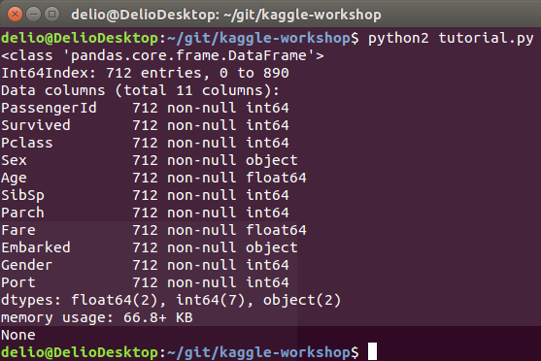
5. Convert All Data to Numerical Data
You can print the information about a DataFrame with:
print(df.info())
Run the script.
Gender and Port exist, but Sex and Embarked need to be removed.

Slide 24
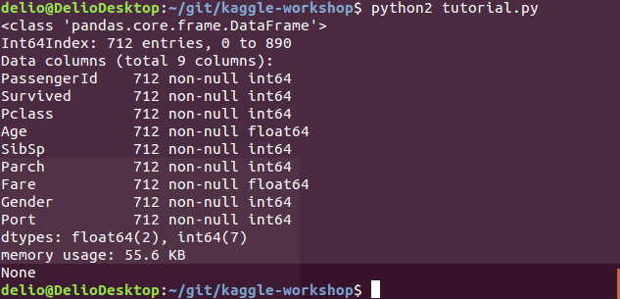
5. Convert All Data to Numerical Data
Drop the obsolete columns and print the info again!
df = df.drop(['Sex', 'Embarked'], axis=1) print(df.info())
Much better!

Slide 25
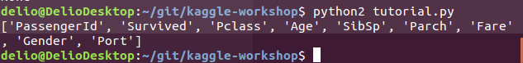
6. Arrange DataFrame for Training
We want to group the training data together, with the columns: ‘Survived’ and ‘PassengerID’ off to the side. It is preferred that the classification column (‘Survived’) is the furthest on one end.
cols = df.columns.tolist() print(cols)

Slide 26
6. Arrange DataFrame for Training
Let’s move: ‘Survived’ at index 1 to index 0 ‘PassengerId’ at index 0 to index 1 Remainder can stay the way it is. cols = [cols[1]] + [cols[0]] + cols[2:] df = df[cols] #remakes the DataFrame with the new order of cols

Slide 27
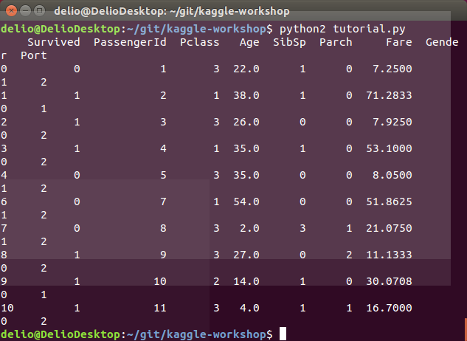
7. Train a Model
Verify that our data is numerical
print(df.head(10))

Slide 28
7. Train a Model
Random Forest Classifier
“A random forest is a meta estimator that fits a number of decision tree classifiers on various sub-samples of the dataset and use averaging to improve the predictive accuracy and control over-fitting. The sub-sample size is always the same as the original input sample size but the samples are drawn with replacement if bootstrap=True (default).” - SciKit Learn
Documentation: http://scikit-learn.org/stable/modules/generated/sklearn.ensemble.RandomForestClassifier.html

Slide 29
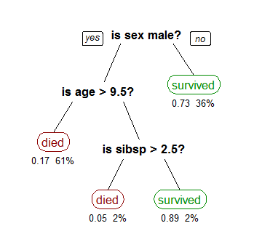
7. Train a Model
A single Decision Tree in the Random Forest could look something like this example on the Wikipedia’s page on Decision Trees which was created from the same Titanic data we are using!

Slide 30
7. Train a Model
Select the values from the DataFrame
train_data = df.values
Import the RandomForestClassifier and make a classifier with 100 trees.
from sklearn.ensemble import RandomForestClassifier rfc = RandomForestClassifier(n_estimators = 100)

Slide 31
7. Train a Model
Training data is the Pclass, Age, SibSp, Parch, Fare, Gender and Port columns (columns 2 to the end)
Labels data is the Survived column (column 0)
We want all rows from our training data set.
model = rfc.fit(train_data[0:,2:], train_data[0:,0])

Slide 32
8. Make Predictions
Just as we loaded the train.csv, we need to load the test.csv
df_test = pd.read_csv('data/test.csv')

Slide 34
8. Make Predictions
The only difference between the train.csv and the test.csv is the “Survived” column
Use fillna(0) instead of dropna(), since Kaggle expects a prediction for every row in the test data
df_test = df_test.drop(['Name', 'Ticket', 'Cabin'], axis=1) df_test = df_test.fillna(0) df_test['Gender'] = df_test['Sex'].map({'female': 0, 'male':1}) df_test['Port'] = df_test['Embarked'].map({'C':1, 'S':2, 'Q':3}) df_test = df_test.drop(['Sex', 'Embarked'], axis=1)
test_data = df_test.values

Slide 35
8. Make Predictions
Make predictions on all the rows, and from the second column to the end (we don’t include the PassengerId)
pred = model.predict(test_data[:,1:])

Slide 36
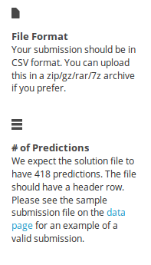
9. Format Predictions for Kaggle Submission
We need to have 418 predictions (same amount of rows in the test.csv)
Must have a header row

Slide 37
9. Format Predictions for Kaggle Submission
Combine the PassengerId column from the test_df with the predictions
result = np.c_[test_data[:,0].astype(int), pred.astype(int)]

Slide 38
9. Format Predictions for Kaggle Submission
Add the header row
df_result = pd.DataFrame(result[:,0:2], columns=['PassengerId', 'Survived'])

Slide 39
9. Format Predictions for Kaggle Submission
Output the result to titanic1.csv
df_result.to_csv('titanic1.csv', index=False)
Now run the script!

Slide 40
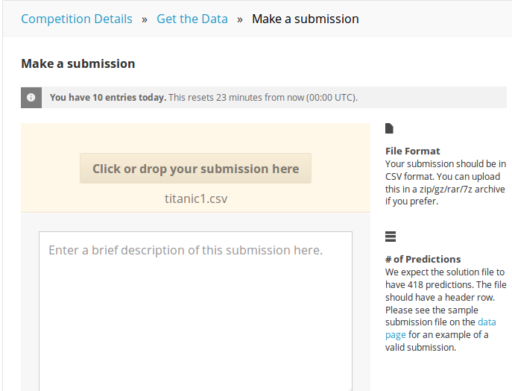
9. Format Predictions for Kaggle Submission
Submit your file!
https://www.kaggle.com/c/titanic/submissions/attach

Slide 41
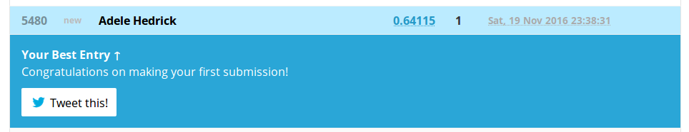
9. Format Predictions for Kaggle Submission
Wow this is bad!

Slide 42
Improvements
Filling missing values rather than dropping them or replacing with 0
Creating dummy variables
Parameter tuning

Slide 43
Improvements
Open up tutorial2.py in the project folder
The numbers in the headers for the following slides correspond with the numbered sections in the code

Slide 44
Fill Missing Values
Fill in the missing ages with the ages mean for the training data
age_mean = df['Age'].mean() df['Age'] = df['Age'].fillna(age_mean)

Slide 45
Fill Missing Values
Fill Embarked with most frequently occurring value (mode) for the training data
from scipy.stats import mode mode_embarked = mode(df['Embarked'])[0][0] df['Embarked'] = df['Embarked'].fillna(mode_embarked)

Slide 46
4. Fill Missing Values
Fill in the missing ages with the ages mean for the test data df_test['Age'] = df_test['Age'].fillna(age_mean)

Slide 47
4. Fill Missing Values
Create a pivot table of fare means for each Pclass fare_means = df.pivot_table('Fare', index='Pclass', aggfunc='mean')
Fill in the fares with the values from the pivot table if they are missing
df_test['Fare'] = df_test[['Fare', 'Pclass']] .apply(lambda x:fare_means[x['Pclass']] if pd.isnull(x['Fare']) else x['Fare'], axis=1)

Slide 48
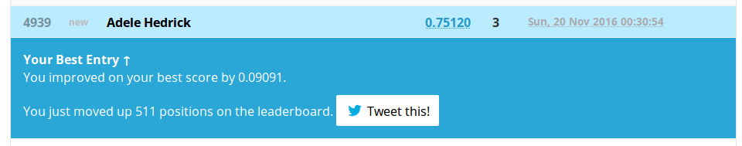
Fill Missing Values
Run it and make a submission with titanic2.csv! A huge improvement!

Slide 49
Dummy Variables
When working with categorical data, like the Embarked column, best practice is to turn it into dummy variables
Embarked
Q
S
Q
S
C
Embarked_Q | Embarked_S | Embarked_C
1 | 0 | 0
0 | 1 | 0
1 | 0 | 0
0 | 1 | 0
0 | 0 | 1

Slide 50
2. Dummy Variables in Training Data
Thankfully using pandas, this is a one liner! df = pd.concat([df, pd.get_dummies(df['Embarked'], prefix='Embarked')], axis=1)

Slide 51
5. Dummy Variables in Test Data
df_test = pd.concat([df_test, pd.get_dummies(df_test['Embarked'], prefix='Embarked')],axis=1)

Slide 52
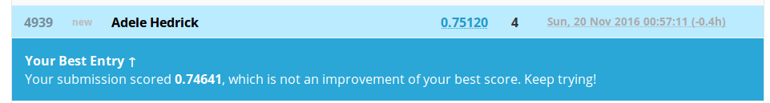
Dummy Variables
Unfortunately, this did not improve our score, but when using other classifiers, this would be an important step.

Slide 53
3. Parameter Tuning
RandomForestClassifier has many parameters, and the values that best optimize your model are not very intuitive.
One solution is fitting the training data multiple times on different parameters, and selecting the best result from your outputs.

Slide 54
3. Parameter Tuning
Using GridSearchCV we can make a better model!
from sklearn.model_selection import GridSearchCV
# parameters and their ranges to try parameter_grid = { 'max_features': [0.5, 1.], 'max_depth': [5., None] } rfc = GridSearchCV(RandomForestClassifier(n_estimators = 100), parameter_grid, cv=5, verbose=3)

Slide 55
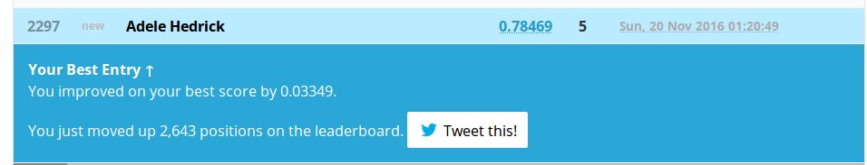
Parameter Tuning
We made another improvement!

Slide 56
Want More?
Some of my favourite (and free) online courses :
Introduction to Machine Learning on Udacity
Stanford Machine Learning course on Coursera
Another great package repository
https://www.continuum.io/downloads

